Slide 1


Data Management
Sahar Khanlari - 2107563
Marco Natale – 1929854
A.A. 2024/2025

Slide 2

Introduction
SQL vs NoSQL (PostgreSQL vs MongoDB)
Goals:
Interface Usability
Flexibility
Scalability
Performance Queries and Comparison

Slide 3

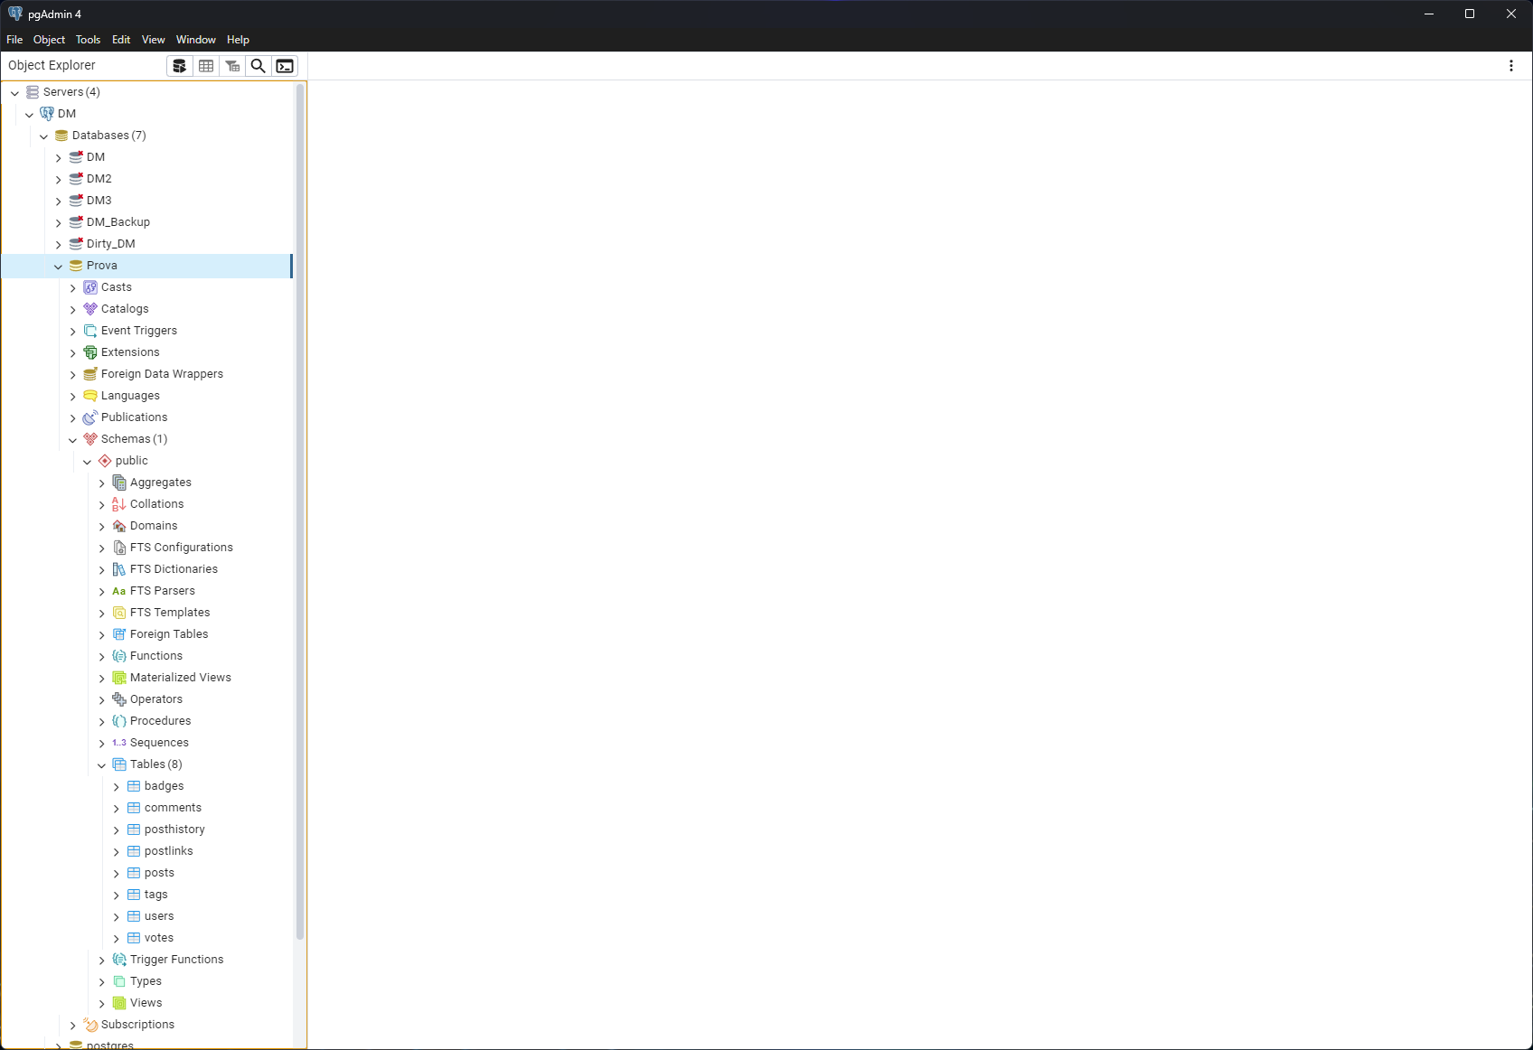
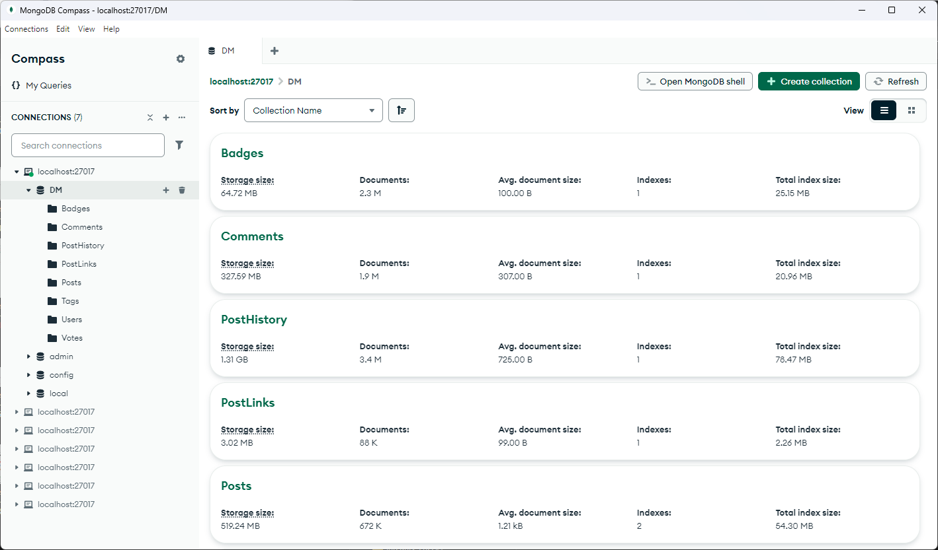
Interface Usability Layout
pgAdmin
MongoDB Compass

Slide 4
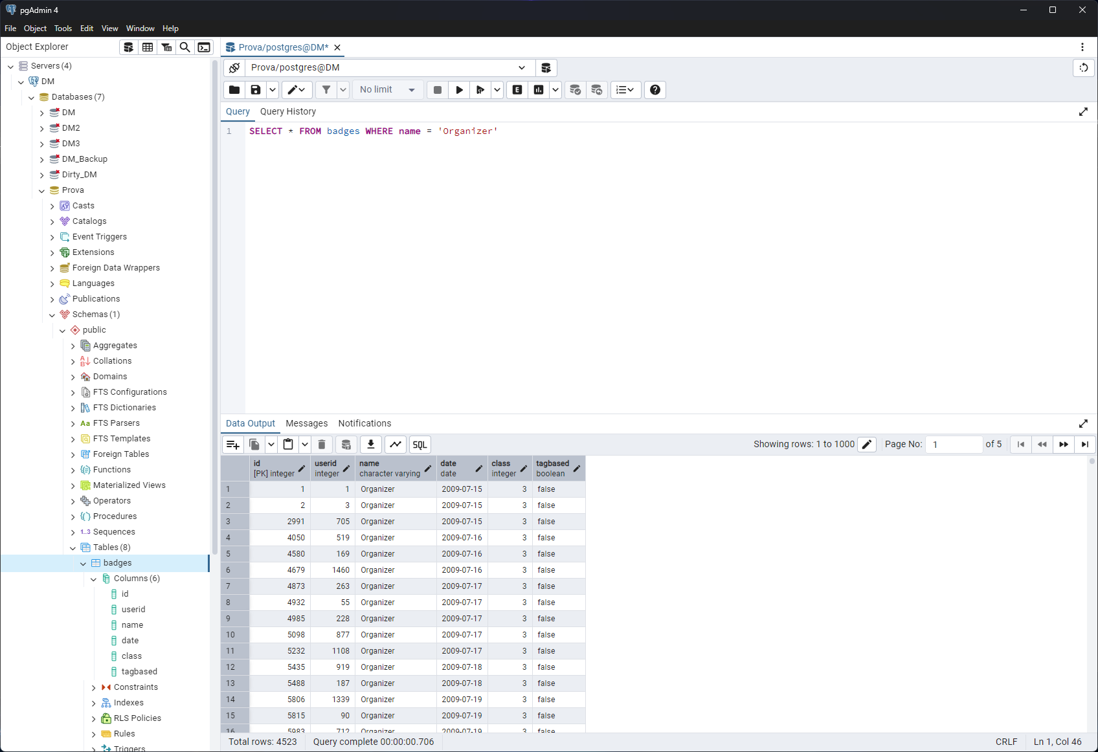
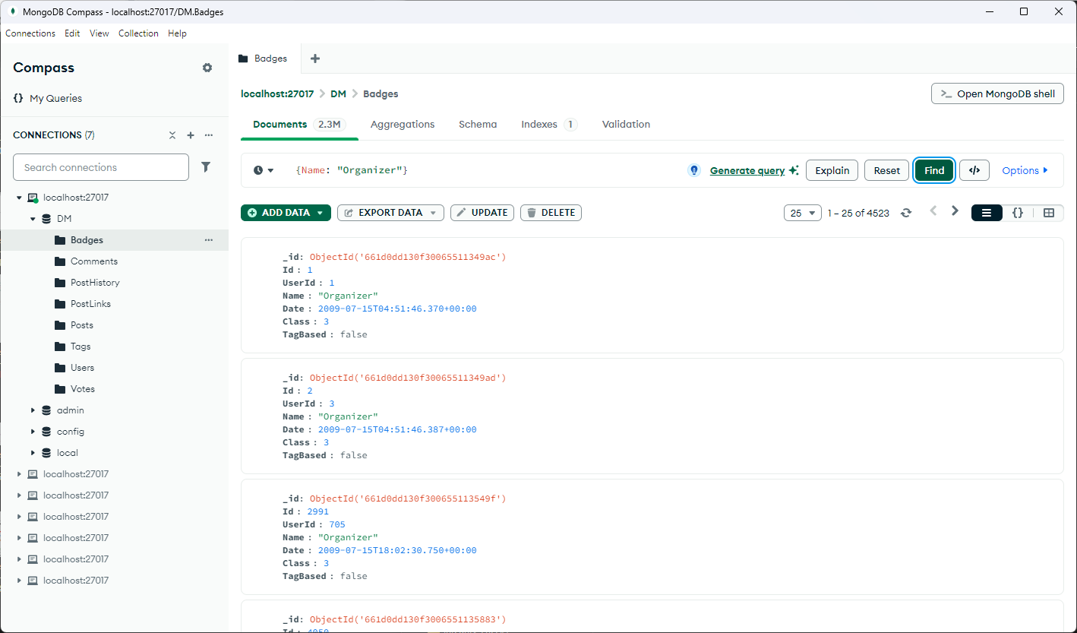
Interface Usability Navigation & Usability
pgAdmin
MongoDB Compass

Slide 5
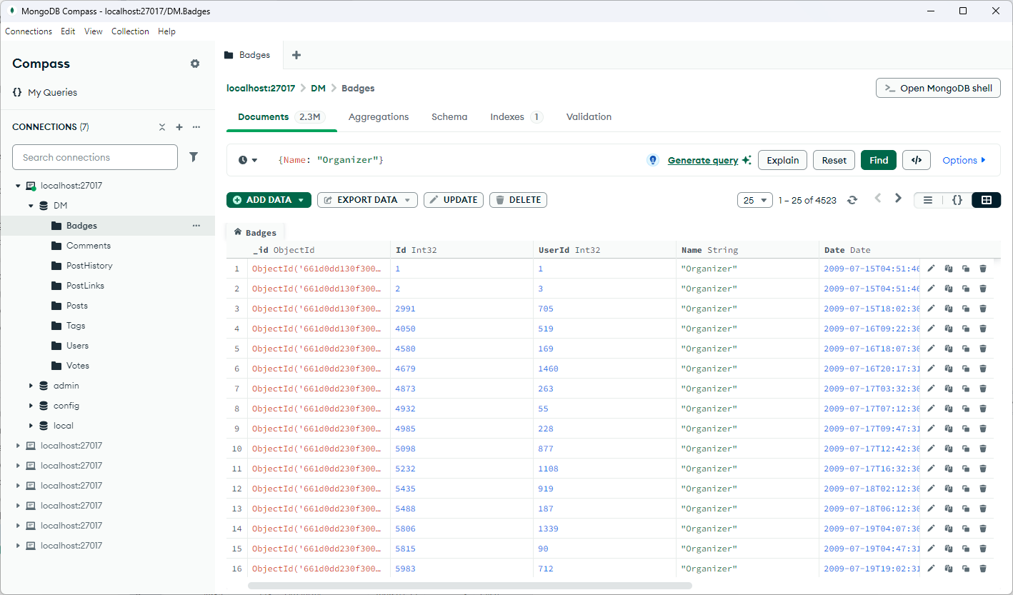
Interface Usability Navigation & Usability
pgAdmin
MongoDB Compass

Slide 6
Interface Usability Functionality
Differences
Query Interface:
pgAdmin: Uses a simple text editor for writing SQL queries.
MongoDB Compass: Provides a visual aggregation pipeline builder for NoSQL queries.
Predefined Queries:
pgAdmin: Offers predefined queries (e.g., view data, CRUD scripts) via right-click.
MongoDB Compass: No predefined SQL-like queries, relies on document-based query building.
Similarities
Both provide a GUI interface for database management.
Both allow import/export of data.
Both include a CLI window for command-line interaction.

Slide 7
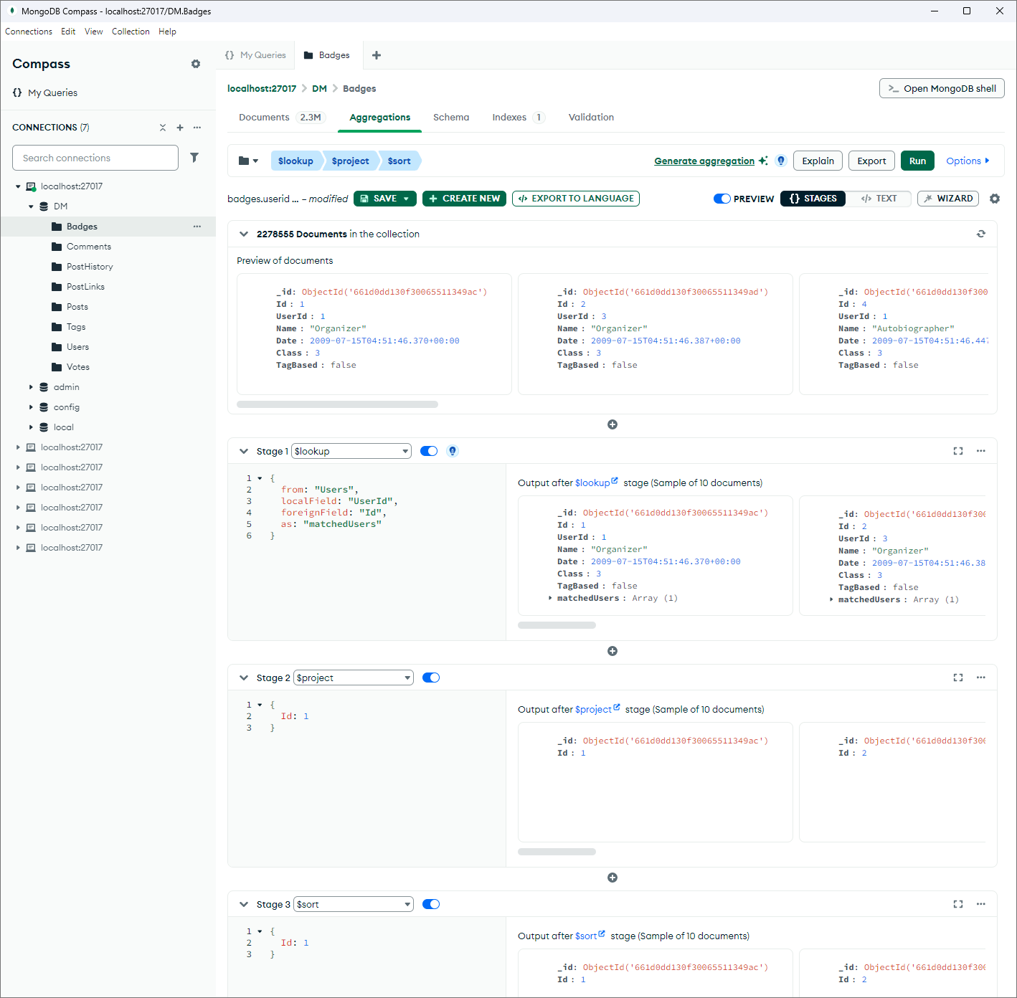
Interface Usability Functionality

Slide 8
Flexibility
Feature | SQL (Relational Databases) | MongoDB (NoSQL)
Schema | Strict, predefined schema | Schema-less (Flexible documents)
Structure | Tables, rows, and columns | Documents (JSON/BSON format)
Data Relationships | Normalized, uses joins to relate tables | Denormalized, embeds related data
Schema Changes | Requires migrations, downtime | Dynamic, fields can be added/removed
Use Case | Best for structured & transactional data | Best for unstructured, evolving data

Slide 9
Scalability
Feature | SQL (Relational Databases) | MongoDB (NoSQL)
Scaling Strategy | Vertical Scaling (Scale-Up) | Horizontal Scaling (Scale-Out)
Data Distribution | Difficult to shard, manual partitioning | Built-in sharding for automatic distribution
Read/Write Performance | Efficient for transactions, joins slow large queries | Faster reads, distributed writes
Replication | Master-slave or cluster-based replication | Replica sets with automatic failover
High Availability | Requires complex setup | Native support for replication & redundancy
Global Distribution | Requires additional tools | Geo-distributed databases supported

Slide 10
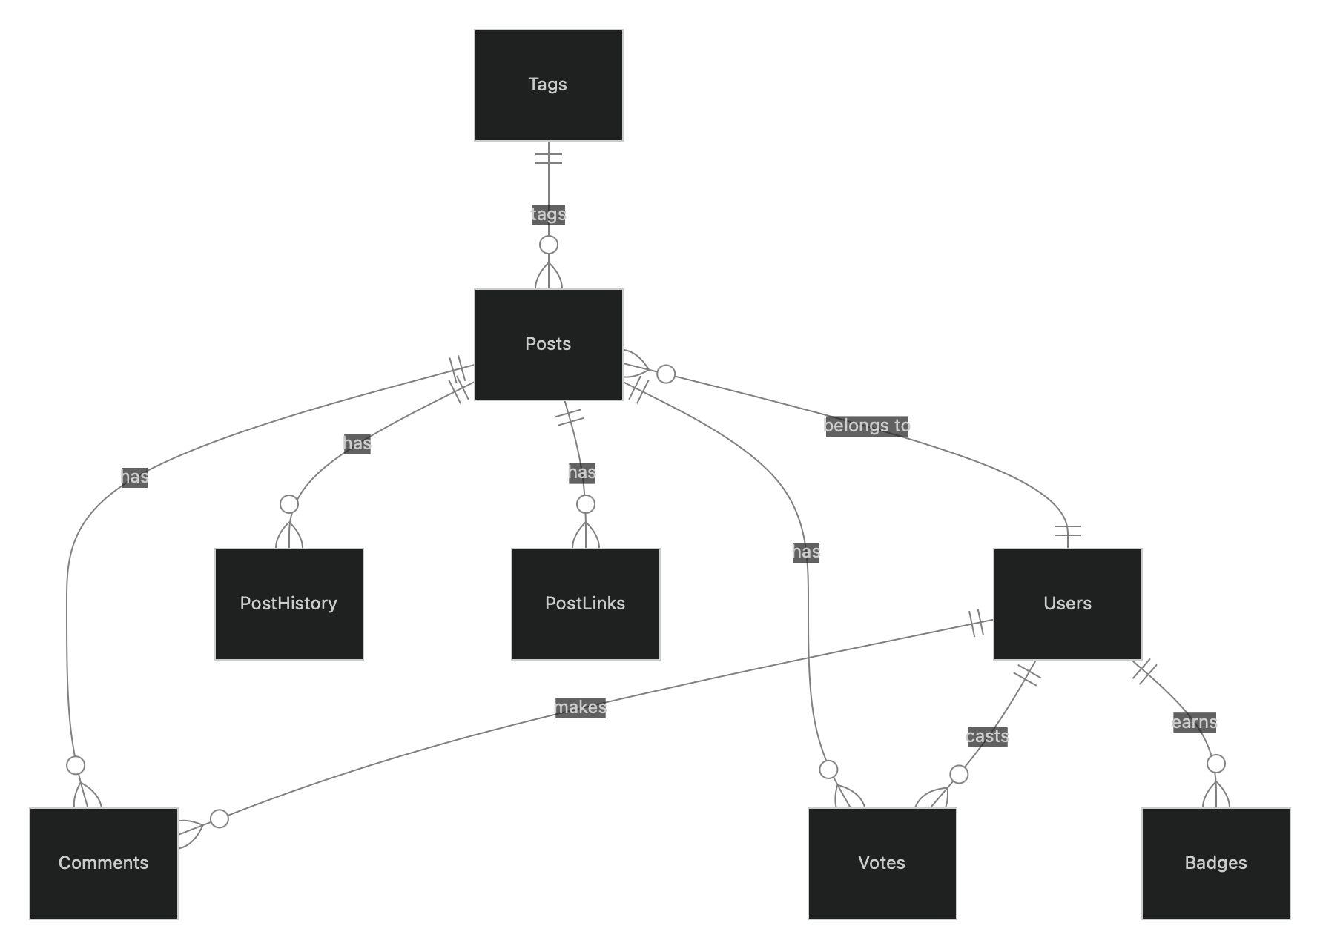
The Dataset

Slide 11
Importing the tables
PostgreSQL:
Badges: 12,78 sec
Comments: 16,87 sec
PostHistory: 62 sec
PostLinks: 0,72 sec
Posts: 27,38 sec
Tags: 0,11 sec
Users: 14,72 sec
Votes: 23,34 sec
MongoDB doesn’t measure time

Slide 12
Performance
Integrity Checks
Data Cleaning
Foreign Keys (only for SQL)
Different Query Types

Slide 13
Key Observation
Checking if PostLinks references Posts
Inefficient query:
SELECT pl.id
FROM postlinks pl
WHERE pl.postid NOT IN (SELECT p.id FROM posts p);
Execution Time: 2 hours 37 minutes
Efficient query:
SELECT pl.id
FROM postlinks pl
EXCEPT
SELECT pl.id
FROM postlinks pl JOIN posts p ON p.id = pl.postid
ORDER BY id;
Execution Time: 258 milliseconds

Slide 14

Key Observation #2
MongoDB requires some indexing for very large data
The queries couldn’t complete/took very long without them
The following indexes have been created:
Posts(Id)
Users(Id)

Slide 15
Integrity Checks
Among 8 queries | PostgreSQL | MongoDB
BEST PostLinks → Posts | 258 ms | 1.825 sec
AVERAGE | 4.212 sec | 33.466 sec (~7x)
WORST Votes → Posts | 7.914 sec | 76.631 sec

Slide 16
Data Cleaning
Among 8 queries | PostgreSQL | MongoDB
BEST PostLinks → Posts | 379 ms | 1.460 sec
AVERAGE | 9.644 sec | 34.108 sec (~2.5x)
WORST | 29.958 sec PostHistory → Posts | 87.51 sec Votes → Posts
Votes table is too large for MongoDB’s $lookup.
PostgreSQL’ s join is optimized on large tables.

Slide 17
Foreign Keys
Posts references:
Users(Id) → OwnerUserId
Posts(Id) → ParentId & AcceptedAnswerId
Comments references:
Posts(Id) → PostId
Votes references:
Users(Id) → UserId
Posts(Id) → PostId
Badges references:
Users(Id) → UserId
PostHistory references:
Users(Id) → UserId
Posts(Id) → PostId
PostLinks references:
Posts(Id) → PostId & RelatedPostId

Slide 18
Performance Queries Overview
 | Read | Write | Joins | Aggregation | Text Search | Nested Updates | Complex Joins | Pagination | Deletion | Count
SQL | 0.779 | 0.453 | 14.673 | 2.236 | 1.286 | 3.259 | 8.998 | 0.583 | >8h | 0.884
MongoDB | 6.867 | 0.003 | 88.112 | 2.518 | 2.3296 | 1.7278 | >6h | 2.470 | 10.869 | 1.144

Slide 19
Simple Read and Write
SELECT *
FROM Posts
WHERE CreationDate BETWEEN '2009-01-01' AND '2009-12-31';
 | Read | Write
SQL | 0.779 | 0.453
INSERT INTO Posts (Id, PostTypeId, CreationDate, Score, Title, Body, Tags)
VALUES
(2, 1, NOW(), 10, 'Title 1', 'Body 1', '<mac><crash>'),
(3, 2, NOW(), 15, 'Title 2', 'Body 2', '<windows>');
Declarative syntax
Standard SQL
posts.find({"CreationDate":
{"$gte": datetime(2009, 1, 1), "$lte": datetime(2009, 12, 31)}
})
 | Read | Write
MongoDB | 6.867 | 0.003
posts.insert_many([
{"Id": 2, "PostTypeId": 1, "CreationDate": datetime.now(), "Score": 10, "Title": "Title 1", "Body": "Body 1", "Tags": "<mac><crash>"},
{"Id": 3, "PostTypeId": 2, "CreationDate": datetime.now(), "Score": 15, "Title": "Title 2", "Body": "Body 2", "Tags": "<windows>"}
])
JSON-like documents
Operators and expressions: $gt, $eq, …

Slide 20
Simple Joins and Aggregations
SELECT p.*, u.DisplayName
FROM Posts p
JOIN Users u ON p.OwnerUserId = u.Id;
 | Joins | Aggregation
SQL | 14.673 | 2.236
SELECT Tags, COUNT(*)
FROM Posts
GROUP BY Tags;
Optimized for joins
Relationships are optimized
Aggregation with group by
posts.aggregate([
{"$lookup": {"from": "Users", "localField": "OwnerUserId", "foreignField": "Id", "as": "owner"}},
{"$unwind": "$owner"},
{"$project": {"_id": 0, "Title": 1, "OwnerDisplayName": "$owner.DisplayName"}}
])
 | Joins | Aggregation
MongoDB | 88.112 | 2.518
posts.aggregate([
{"$unwind": "$Tags"},
{"$group": {"_id": "$Tags", "count": {"$sum": 1}}}
])
No native join operation
$lookup stage is used in aggregations
Aggregation in stages

Slide 21
Text Search and Nested Updates
SELECT *
FROM Posts
WHERE Body LIKE '%virtual machine%';
 | Text Search | Nested Updates
SQL | 1.286 | 3.259
UPDATE Users
SET Reputation = Reputation + 10
WHERE Id IN
(SELECT OwnerUserId
FROM Posts
GROUP BY OwnerUserId
HAVING COUNT(*) > 10);
posts.find({"Body":
{"$regex": "virtual machine", "$options": "i"}
})
 | Text Search | Nested Updates
MongoDB | 2.3296 | 1.7278
owners_with_more_than_10_posts =
posts.aggregate([
{"$group": {"_id": "$OwnerUserId", "postCount": {"$sum": 1}}},
{"$match": {"postCount": {"$gt": 10}}}
])
owner_ids = [owner["_id"] for owner in owners_with_more_than_10_posts]
users.update_many({"Id": {"$in": owner_ids}}, {"$inc": {"Reputation": 10}})

Slide 22
Complex Joins
 | Complex Joins
SQL | 8.998
MongoDB | >6h
SELECT p.Title, c.Text, u.DisplayName
FROM Posts p
JOIN Comments c ON p.Id = c.PostId
JOIN Users u ON c.UserId = u.Id;
posts.aggregate([
{"$lookup": {"from": "Comments", "localField": "Id", "foreignField": "PostId", "as": "comments"}},
{"$unwind": "$comments"},
{"$lookup": {"from": "Users", "localField": "comments.UserId", "foreignField": "Id", "as": "commentUser"}},
{"$unwind": "$commentUser"},
{"$project": {"_id": 0, "Title": 1, "CommentText": "$comments.Text", "CommenterName": "$commentUser.DisplayName"}}
])

Slide 23
Pagination, Deletion and Count
 | Pagination | Deletion | Count
SQL | 0.583 | >8h | 0.884
MongoDB | 2.470 | 10.869 | 1.144
SELECT *
FROM Posts
ORDER BY CreationDate DESC LIMIT 10 OFFSET 20;
DELETE FROM Posts
WHERE Score < 5 AND Id NOT IN (SELECT PostId FROM Comments);
SELECT COUNT(*)
FROM Users
WHERE Reputation > 100;
posts.find().sort("CreationDate", -1).skip(20).limit(10)
post_ids_with_comments = comments.distinct("PostId")
posts.delete_many({"Score": {"$lt": 5}, "Id": {"$nin": post_ids_with_comments}})
users.count_documents({"Reputation": {"$gt": 100}})

Slide 24
Conclusions
 | Read | Write | Joins | Aggregation | Text Search | Nested Updates | Complex Joins | Pagination | Deletion | Count
SQL | 0.779 | 0.453 | 14.673 | 2.236 | 1.286 | 3.259 | 8.998 | 0.583 | >8h | 0.884
MongoDB | 6.867 | 0.003 | 88.112 | 2.518 | 2.3296 | 1.7278 | >6h | 2.470 | 10.869 | 1.144
MongoDB better suited for changing data (faster write, update and delete operations)
PostgreSQL faster in structured data
Use case of this dataset: large forum
→ Dynamic data, but frequent join requests (loading posts and comments)
→ Optimizations are put in place (e.g., on delete set null)

Slide 25
Thank you
Sahar Khanlari - 2107563
Marco Natale – 1929854
A.A. 2024/2025

Slide 26
Query Language Comparison MongoDB
Document-Based Syntax: Uses JSON/BSON for queries.
Example: db["Users"].find({ age: { $gt: 30 } })
Operators & Expressions: Supports $eq, $gt, $in, $and, $or for flexible filtering.
Aggregation Framework: Replaces SQL GROUP BY with a multi-stage pipeline ($match, $group, $project, $sort).
Joins via $lookup: Supports cross-collection joins within aggregation pipelines.
Flexibility: Schema-less design allows dynamic document structure changes.

Slide 27
Query Language Comparison PostgreSQL
Declarative, ANSI-Compliant Syntax: Uses standardized SQL.
Example: SELECT * FROM users WHERE age > 30;
Structured & Schema-Driven: Enforces strong data integrity with predefined tables and relationships.
Powerful Joins & Subqueries: Supports INNER, LEFT, RIGHT, FULL joins and complex queries across multiple tables.
Advanced Aggregation & Window Functions: Uses GROUP BY, window functions, and WITH queries for analytics.
Extensibility: Supports user-defined functions, stored procedures, and procedural languages for business logic.

Slide 28
Query Language Comparison Syntax and Structure
MongoDB:
Uses JSON-like documents to specify query criteria.
Queries are written as object literals, which can be more natural for developers working in JavaScript or other object-oriented languages.
db[“Orders”].find({ status: "shipped", total: { $gte: 50 } })
PostgreSQL:
Uses a declarative, text-based language with clear keywords.
The language is standardized, making it easier to port skills between different SQL databases.
SELECT * FROM orders WHERE status = 'shipped' AND total >= 50;

Slide 29
Query Language Comparison Data Model
MongoDB:
Designed for hierarchical, nested data. Its query language naturally expresses conditions on embedded documents and arrays.
Aggregation pipelines can perform multi-stage transformations that align with the flexible document model.
PostgreSQL:
Optimized for flat, tabular data. SQL queries express relationships and joins between tables through well-defined keys.
Complex aggregations, subqueries, and window functions enable robust data analysis on structured datasets.

Slide 30
Query Language Comparison Joins and Relationships
MongoDB:
Lacks a native, SQL-like join operation because the data is often stored in denormalized documents.
Uses the $lookup stage in aggregation pipelines for joining documents from different collections, but with more limited capabilities compared to SQL joins.
PostgreSQL:
Joins are first-class citizens. You can easily join tables with various join types, which is essential for normalized data models.
The declarative nature of SQL joins makes it straightforward to enforce relationships and retrieve combined datasets.

Slide 31
Query Language Comparison Aggregations
MongoDB:
The aggregation pipeline provides a procedural approach where each stage transforms the data gradually.
This can be very powerful for operations such as grouping, filtering, and reshaping data within a document-centric model.
PostgreSQL:
Uses aggregate functions with GROUP BY clauses and advanced window functions to compute summaries.
The set-based nature of SQL makes it efficient for operations that work across rows of data in a table.

